Slide 1
Temporal Analysis of Groucho Mediated Gene Regulation in the Drosophila Embryo
Michael Chambers
Albert Courey Lab
UCLA
Oct 2015

Slide 2
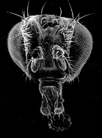
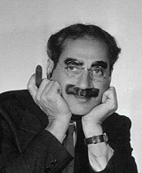
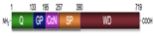
Groucho (Gro) Groucho Marx
groucho¹
groucho^{Marx}
groucho mutant results in extra supraorbital bristles
Gro
R
A
OFF
CRM

Slide 3
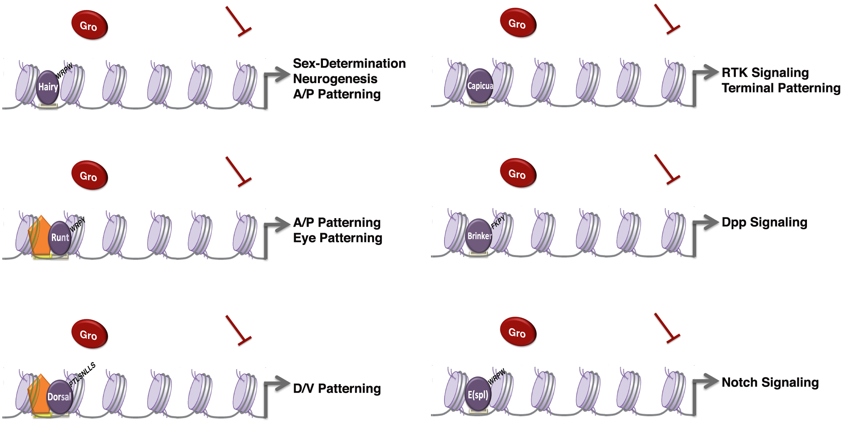
Groucho is required by many different DNA-bound repressors
image courtesy Wiam Turki-Judeh
Notes:
----- Meeting Notes (2/25/15 11:01) -----
Morphogen gradients
dorsal nfkb
hairy hes
runt aml
Tie into human homologs
capicua hmg box family

Slide 4
There is evidence for multiple mechanisms of Gro mediated repression
Seikya and Zaret, 2007
Zhang and Emmons, 2002
Cai et al, 2003
Figures Turki-Judeh and Courey, 2012
Notes:
Add courey reference
unc-37 genetic interaction with MED1 and MED12 (SOP1 and SOP3 in C elegans)
Mention chromatin condensation
----- Meeting Notes (5/30/13 12:52) -----
Title: There is evidence for multiple mechanisms of Gro mediated repression
----- Meeting Notes (3/19/14 14:01) -----
Long range vs short range repression
----- Meeting Notes (2/25/15 11:01) -----
Mediator is tenuous
Animate
----- Meeting Notes (3/2/15 14:31) -----
use primary paper
chen et al
winkler et al
mol cell ken zarat

Slide 5


Genomic scale analysis will provide significant insight into Groucho’s functions in early fly development
Embryo
24 hr
Larva
4 days
Pupae
5 days
Adult
RNA-seq
Nascent-seq
ChIP-seq
mRNA accumulation
mRNA transcription rate
Groucho binding
Notes:
nascent-seq: Distribution of ternary elongation complexes
----- Meeting Notes (5/30/13 12:52) -----
Genome-wide instead of genomic scale
24 hr embryogenesis
Pupal 5 days ?
Histone marks under chip-seq

Slide 6
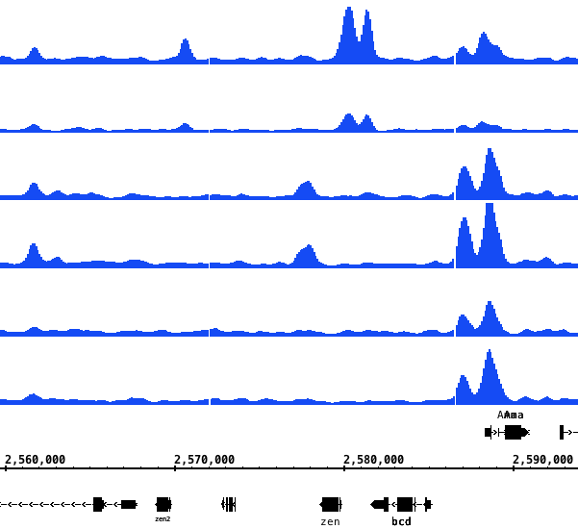
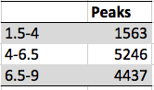
Groucho recruitment is more dynamic during early developmental stages
4 - 6.5 H
6.5 - 9 H
1.5 - 4 H
3056
1.5 - 4
1409
717
64
2311
782
4 – 6.5
6.5 – 9
zen2
zen
bcd
Notes:
Numbers should be bigger (a general problem)
Gene names should be bigger
----- Meeting Notes (2/25/15 11:01) -----
upstream of zen known ventral regulation
Two zen response elements upstream
Originally defined and perhaps "shadow" enhancer described by Levine
One replicate per timetpon
Transition to chip-seq should be smoother
Show multiple genomic loci
----- Meeting Notes (3/2/15 15:03) -----
Integrate macs2 bed file
zen ventral repression region (dorsal)

Slide 7
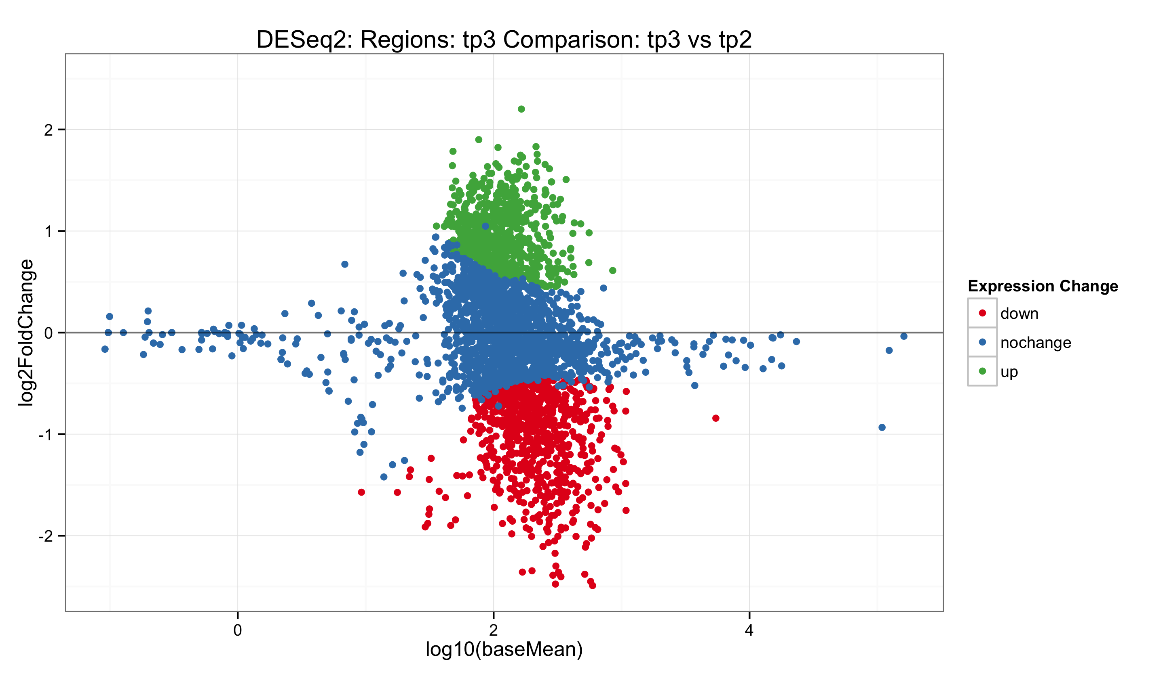
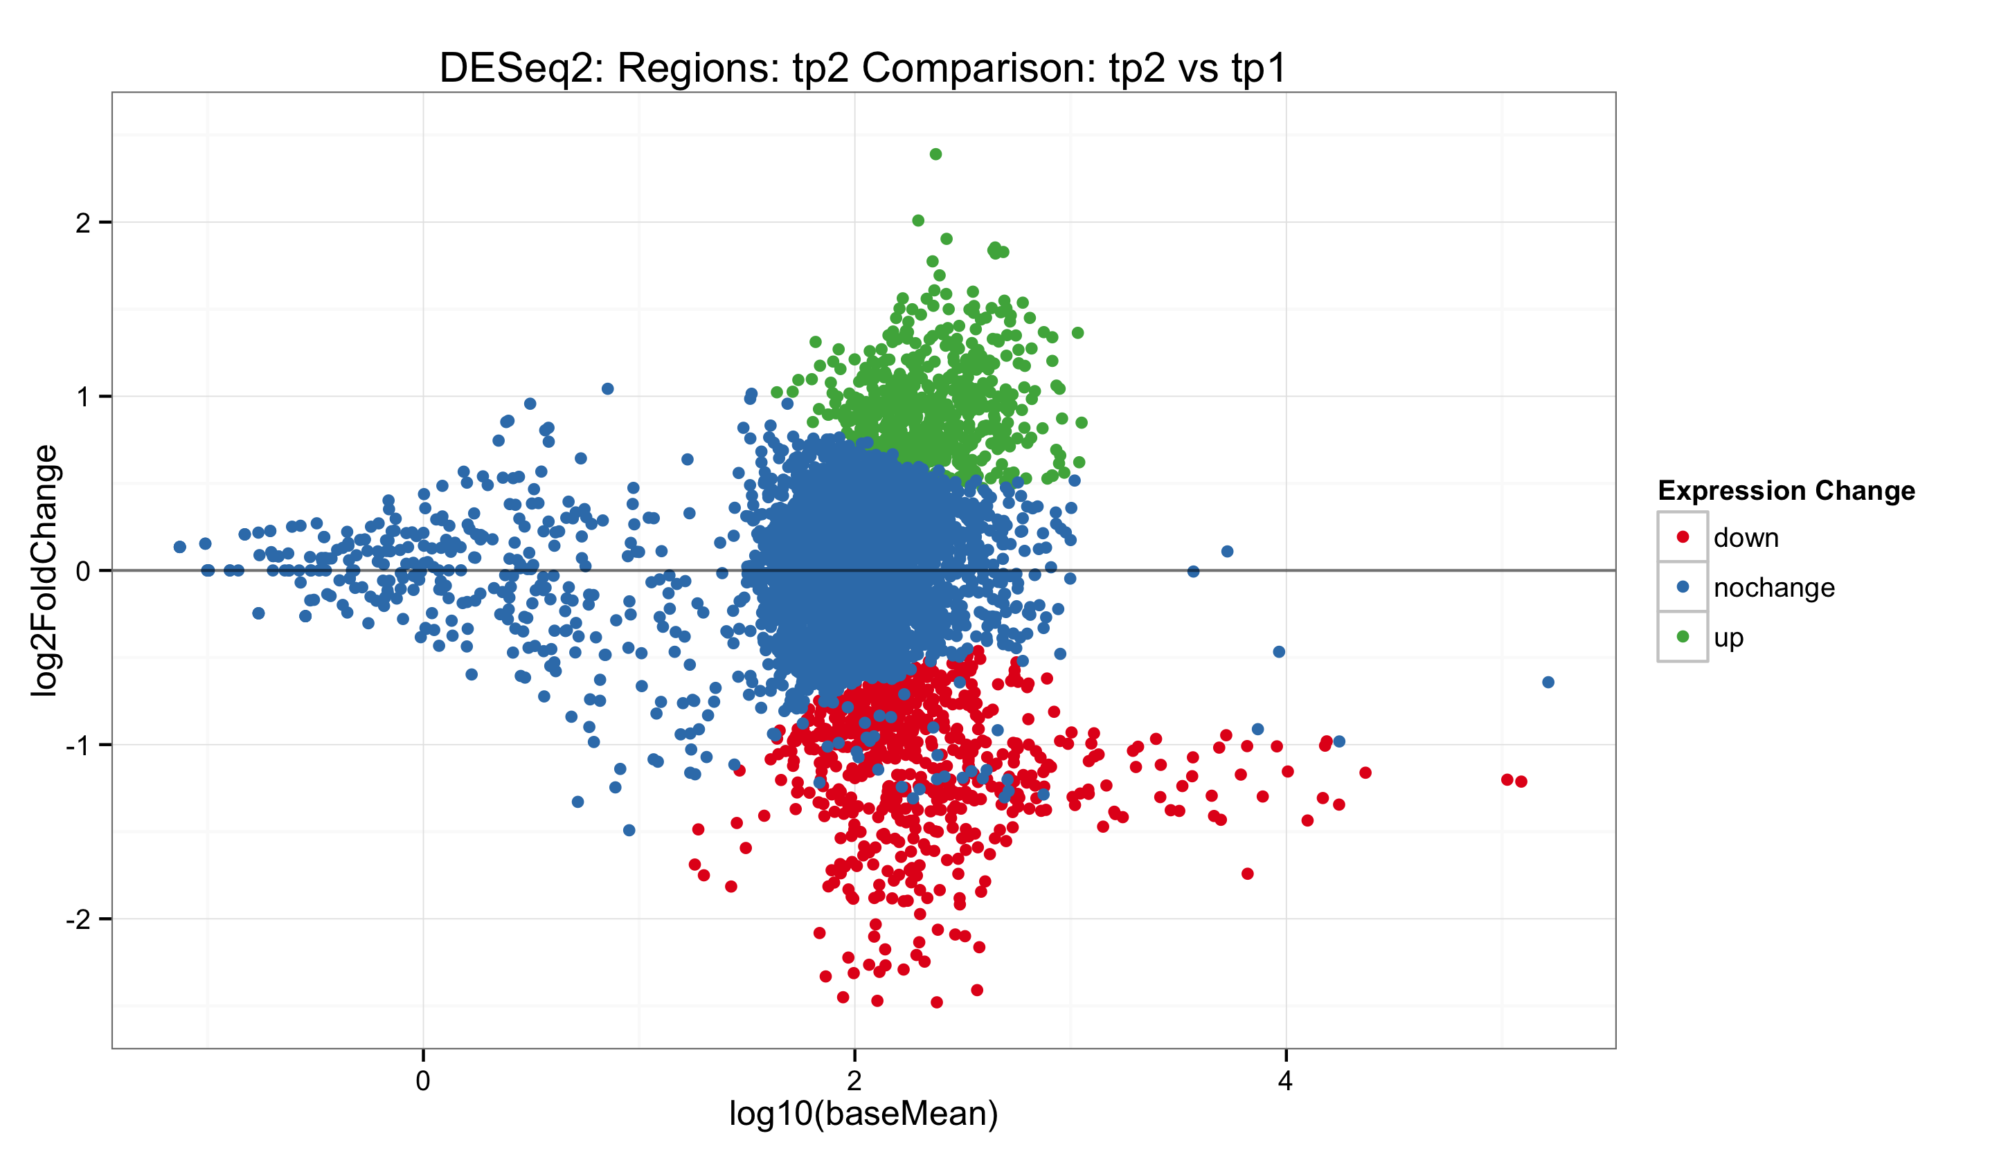
Highly-occupied Gro sites decrease in occupancy at later time stages

Slide 8
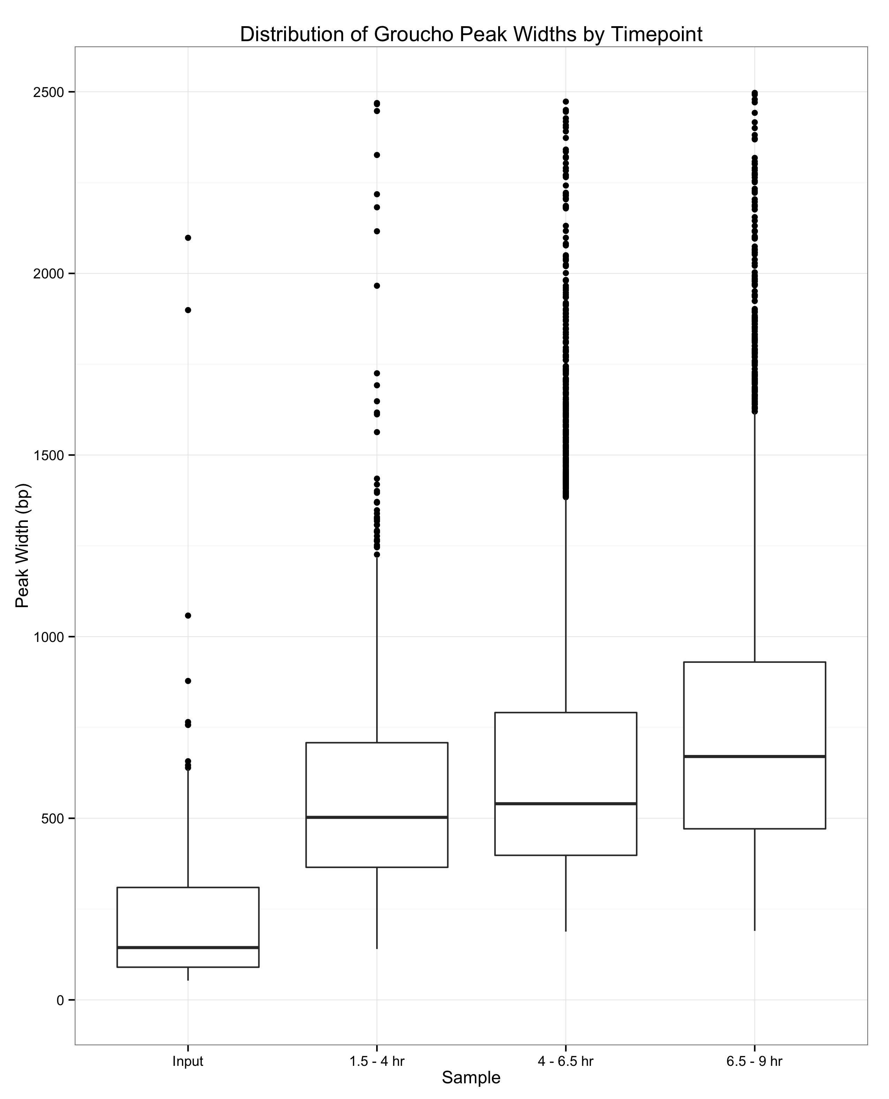
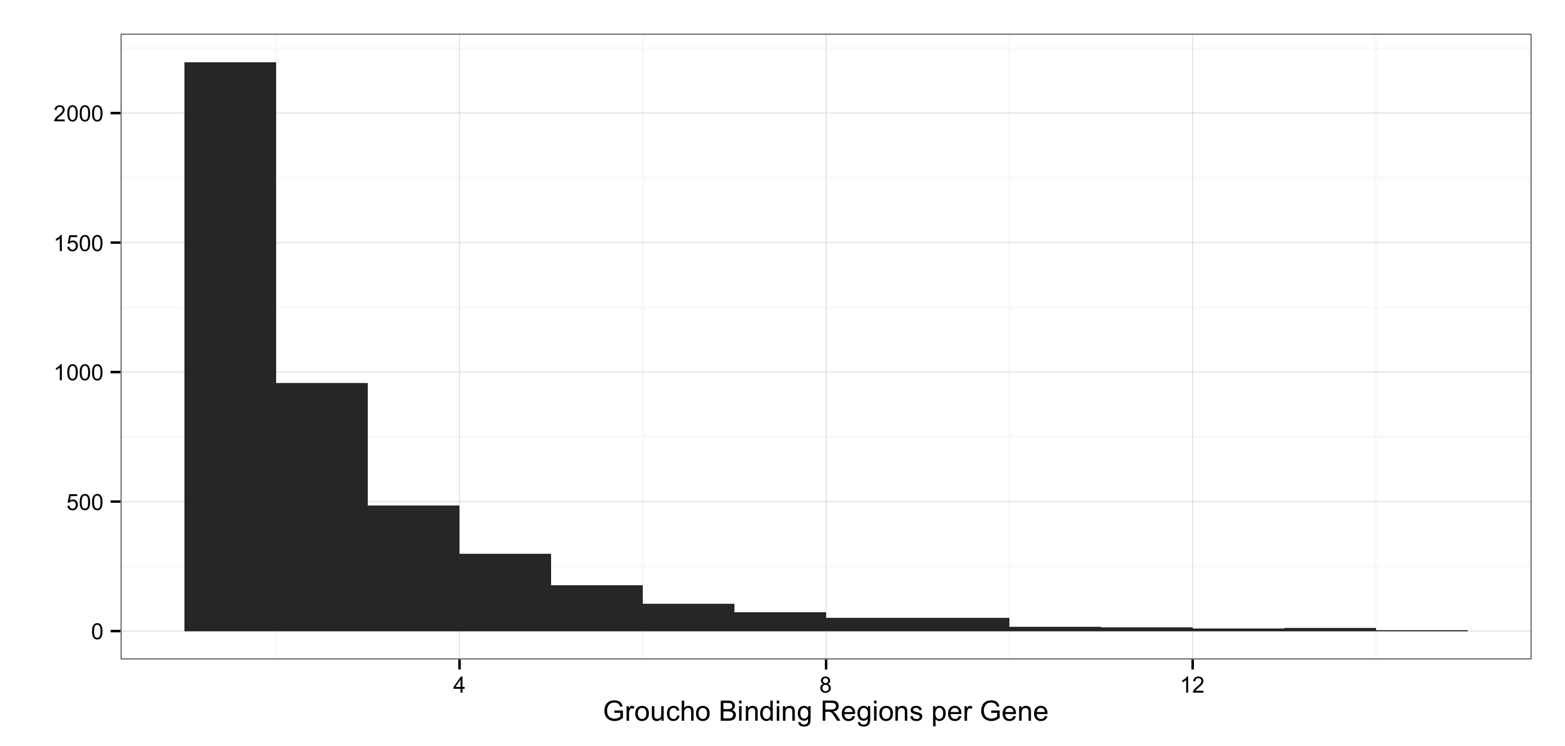
Groucho spreading is not an obligate feature of repression
Notes:
# of binding segments predictive of gro regulation???
Bring into focus into looping
"Now I'm going to introduce data about concept of spreading versus looping..."
----- Meeting Notes (2/25/15 11:01) -----
Gene
----- Meeting Notes (3/2/15 15:03) -----
Remove input
Remove pie chart
Replace w/ two genome views showing typical and spreading behavior

Slide 9
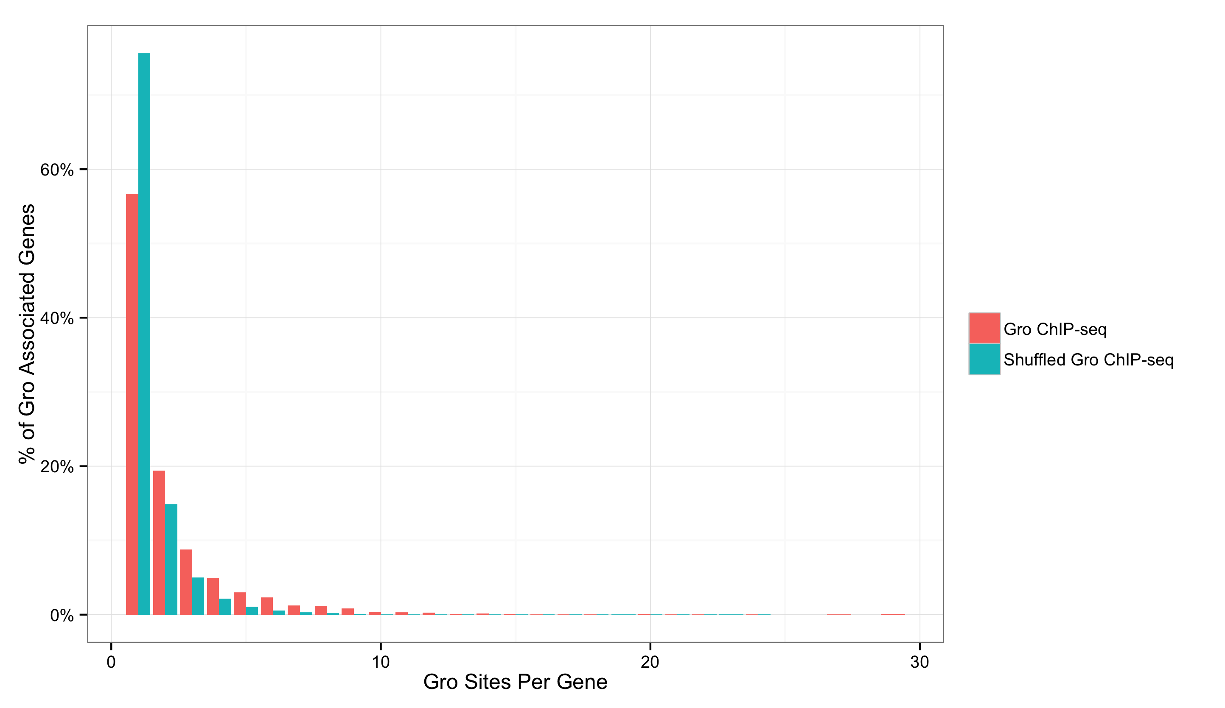
Gro associated genes exhibit more discrete Gro peaks than expected from a 1:1 gene to recruitment site ratio

Slide 10
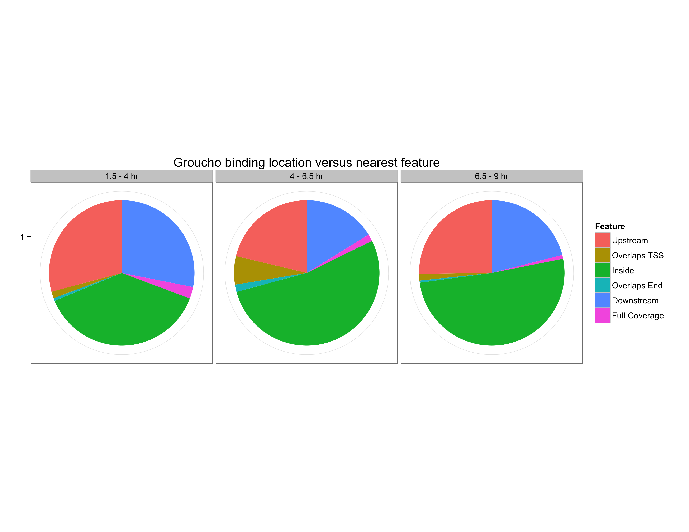
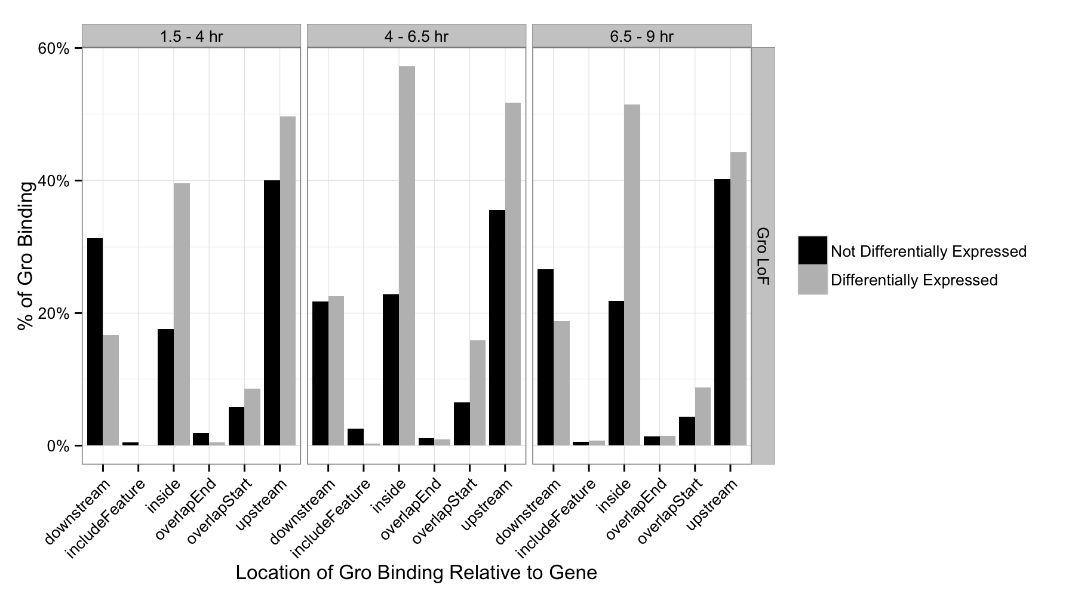
Gro is predominately recruited inside gene bodies of both regulated and non-regulated genes

Slide 11
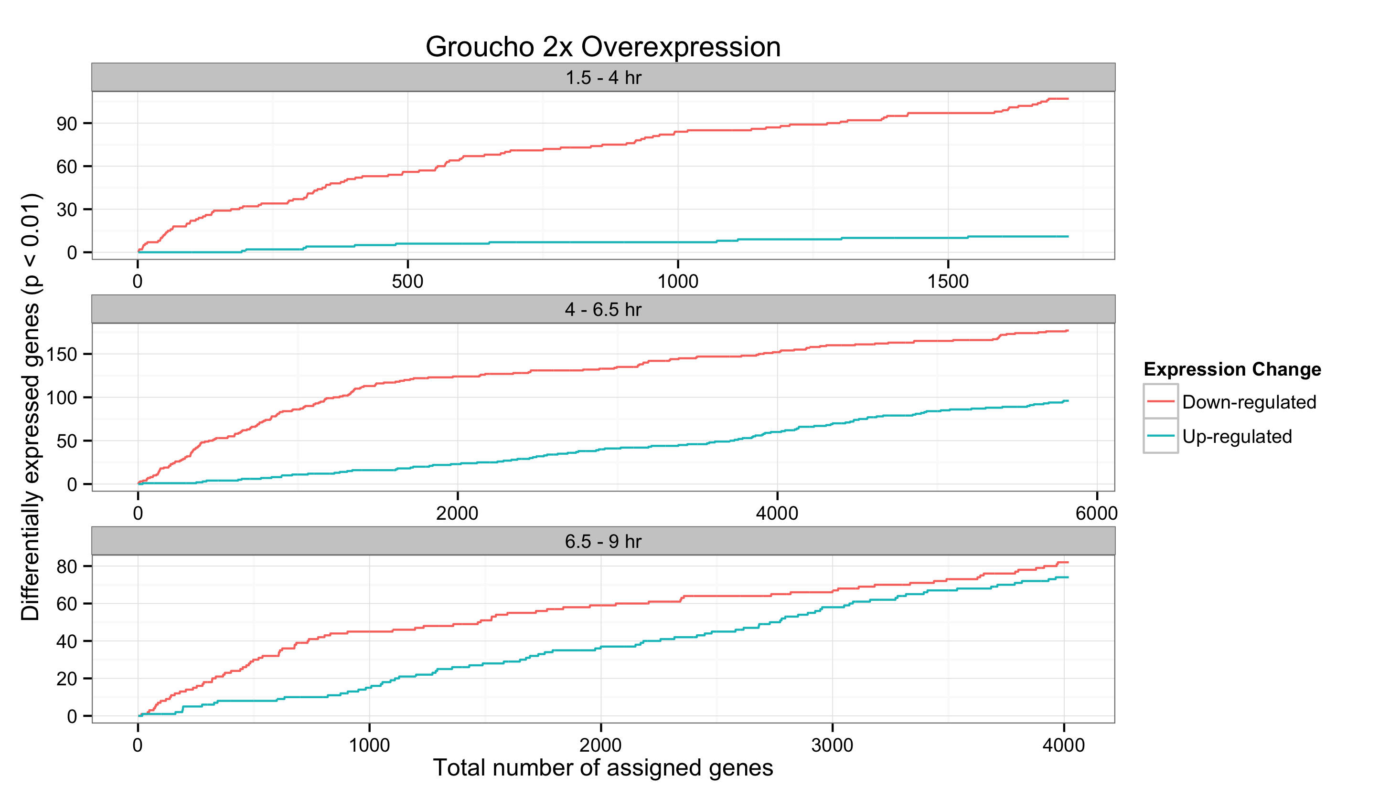
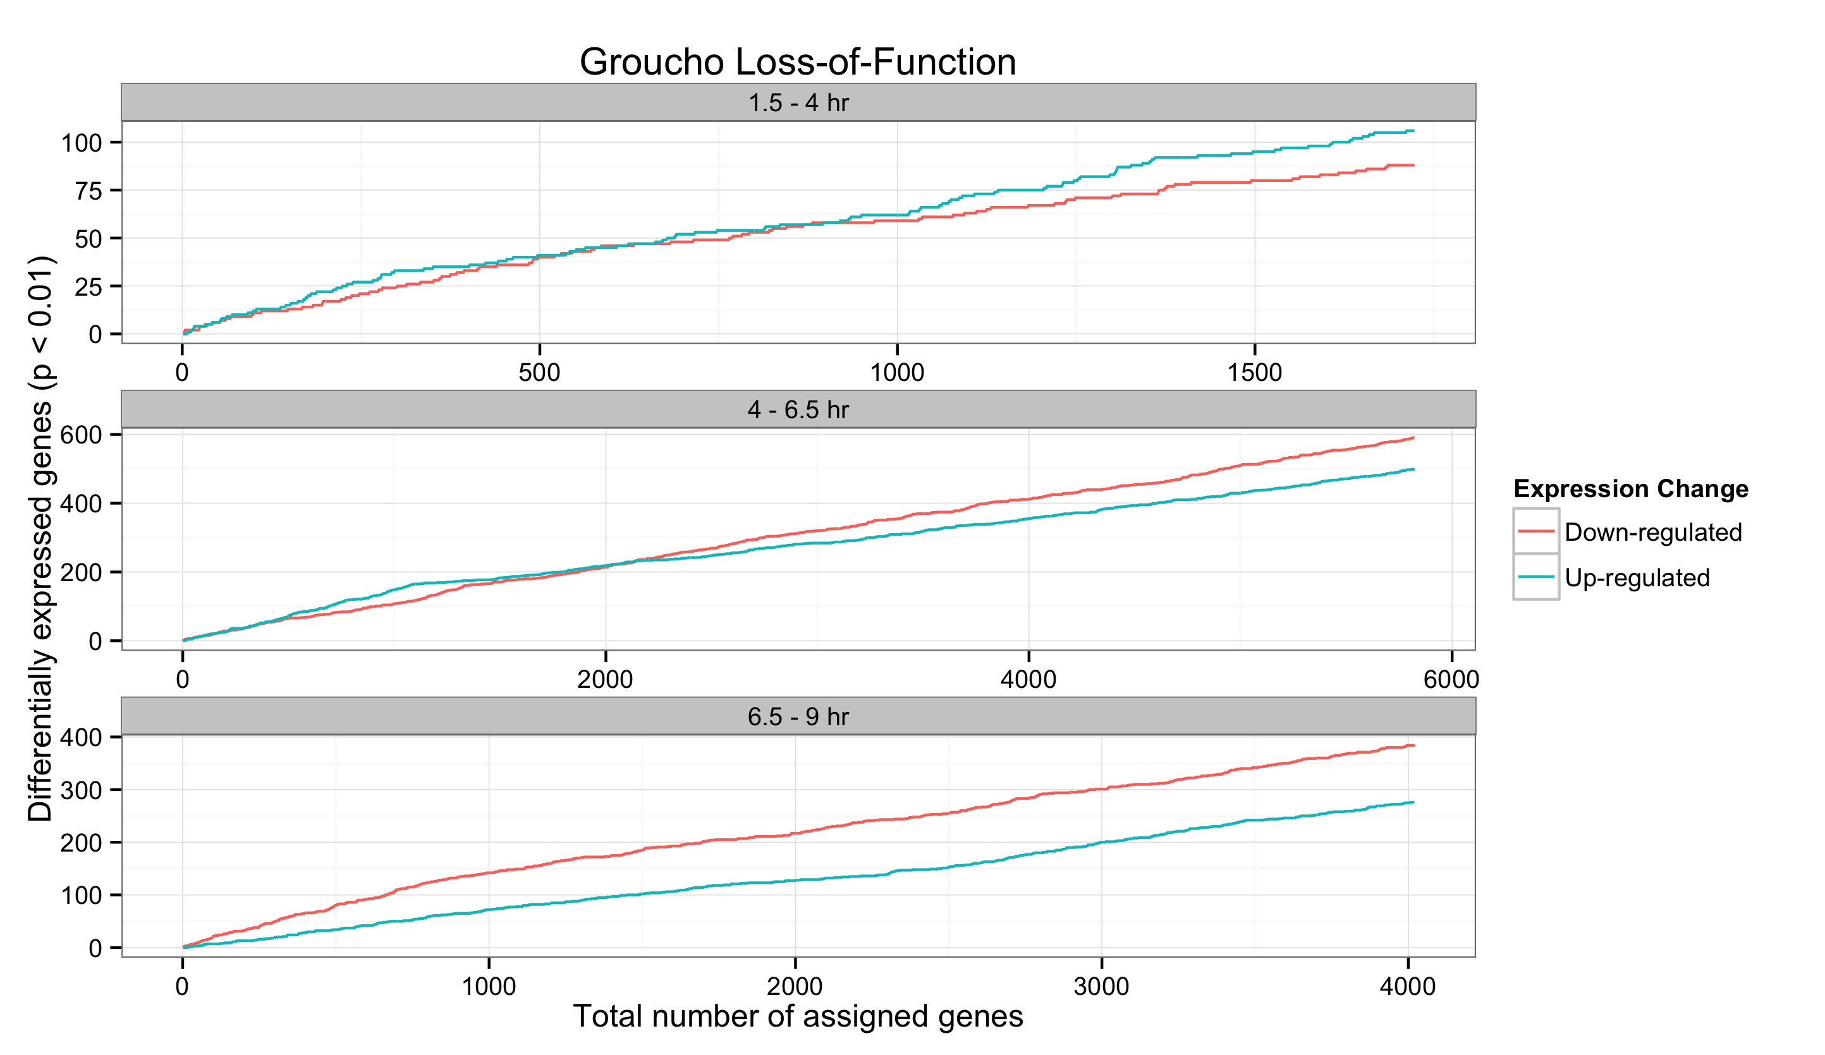
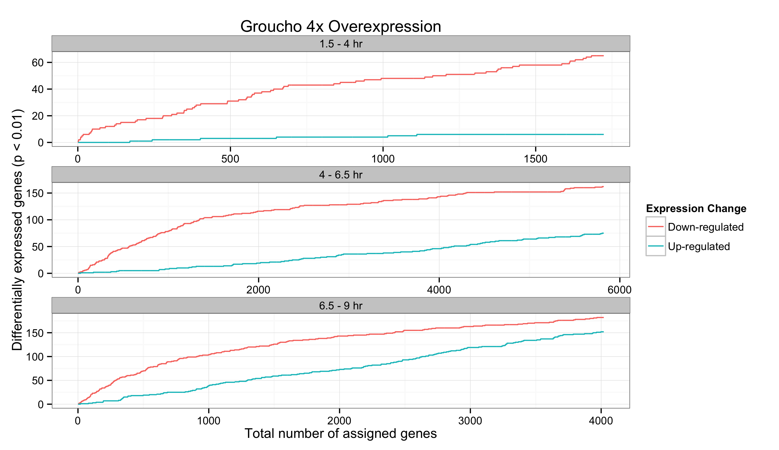
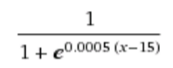
Gro occupancy is predictive of Gro-mediated regulation
∑

Slide 12
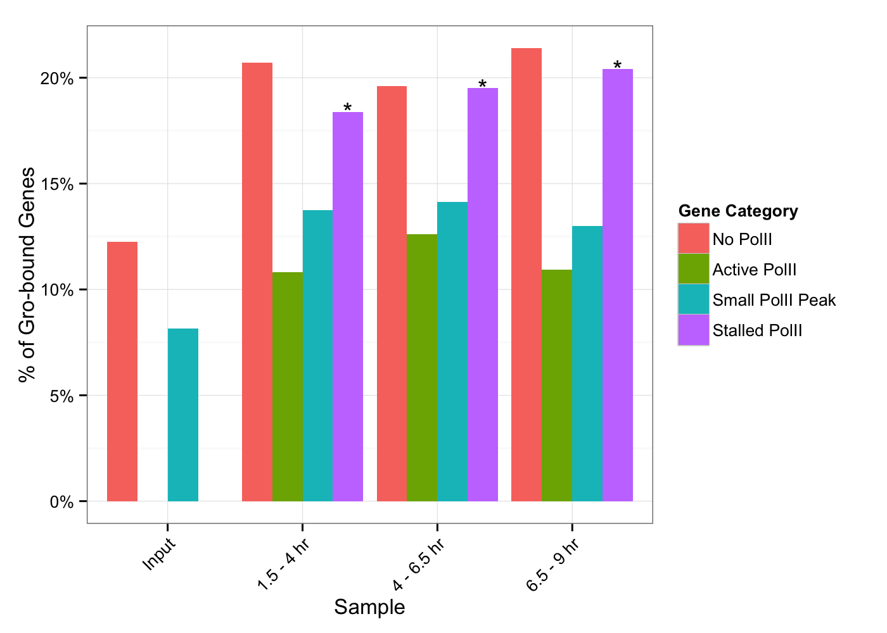
Groucho regulated genes are enriched for stalled PolII

Slide 13
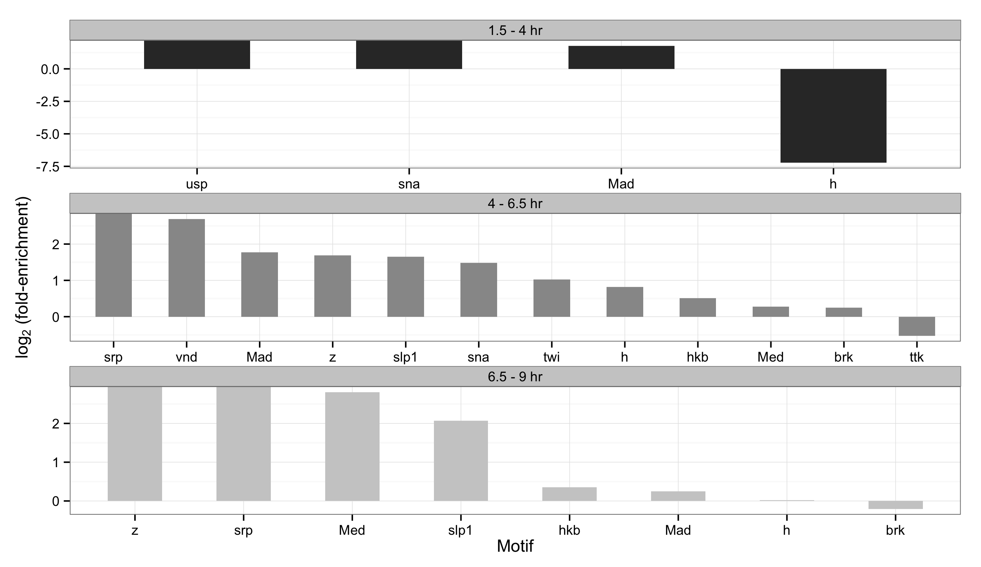
Gro binding sites are enriched for multiple binding sites, differing by developmental stage

Slide 14
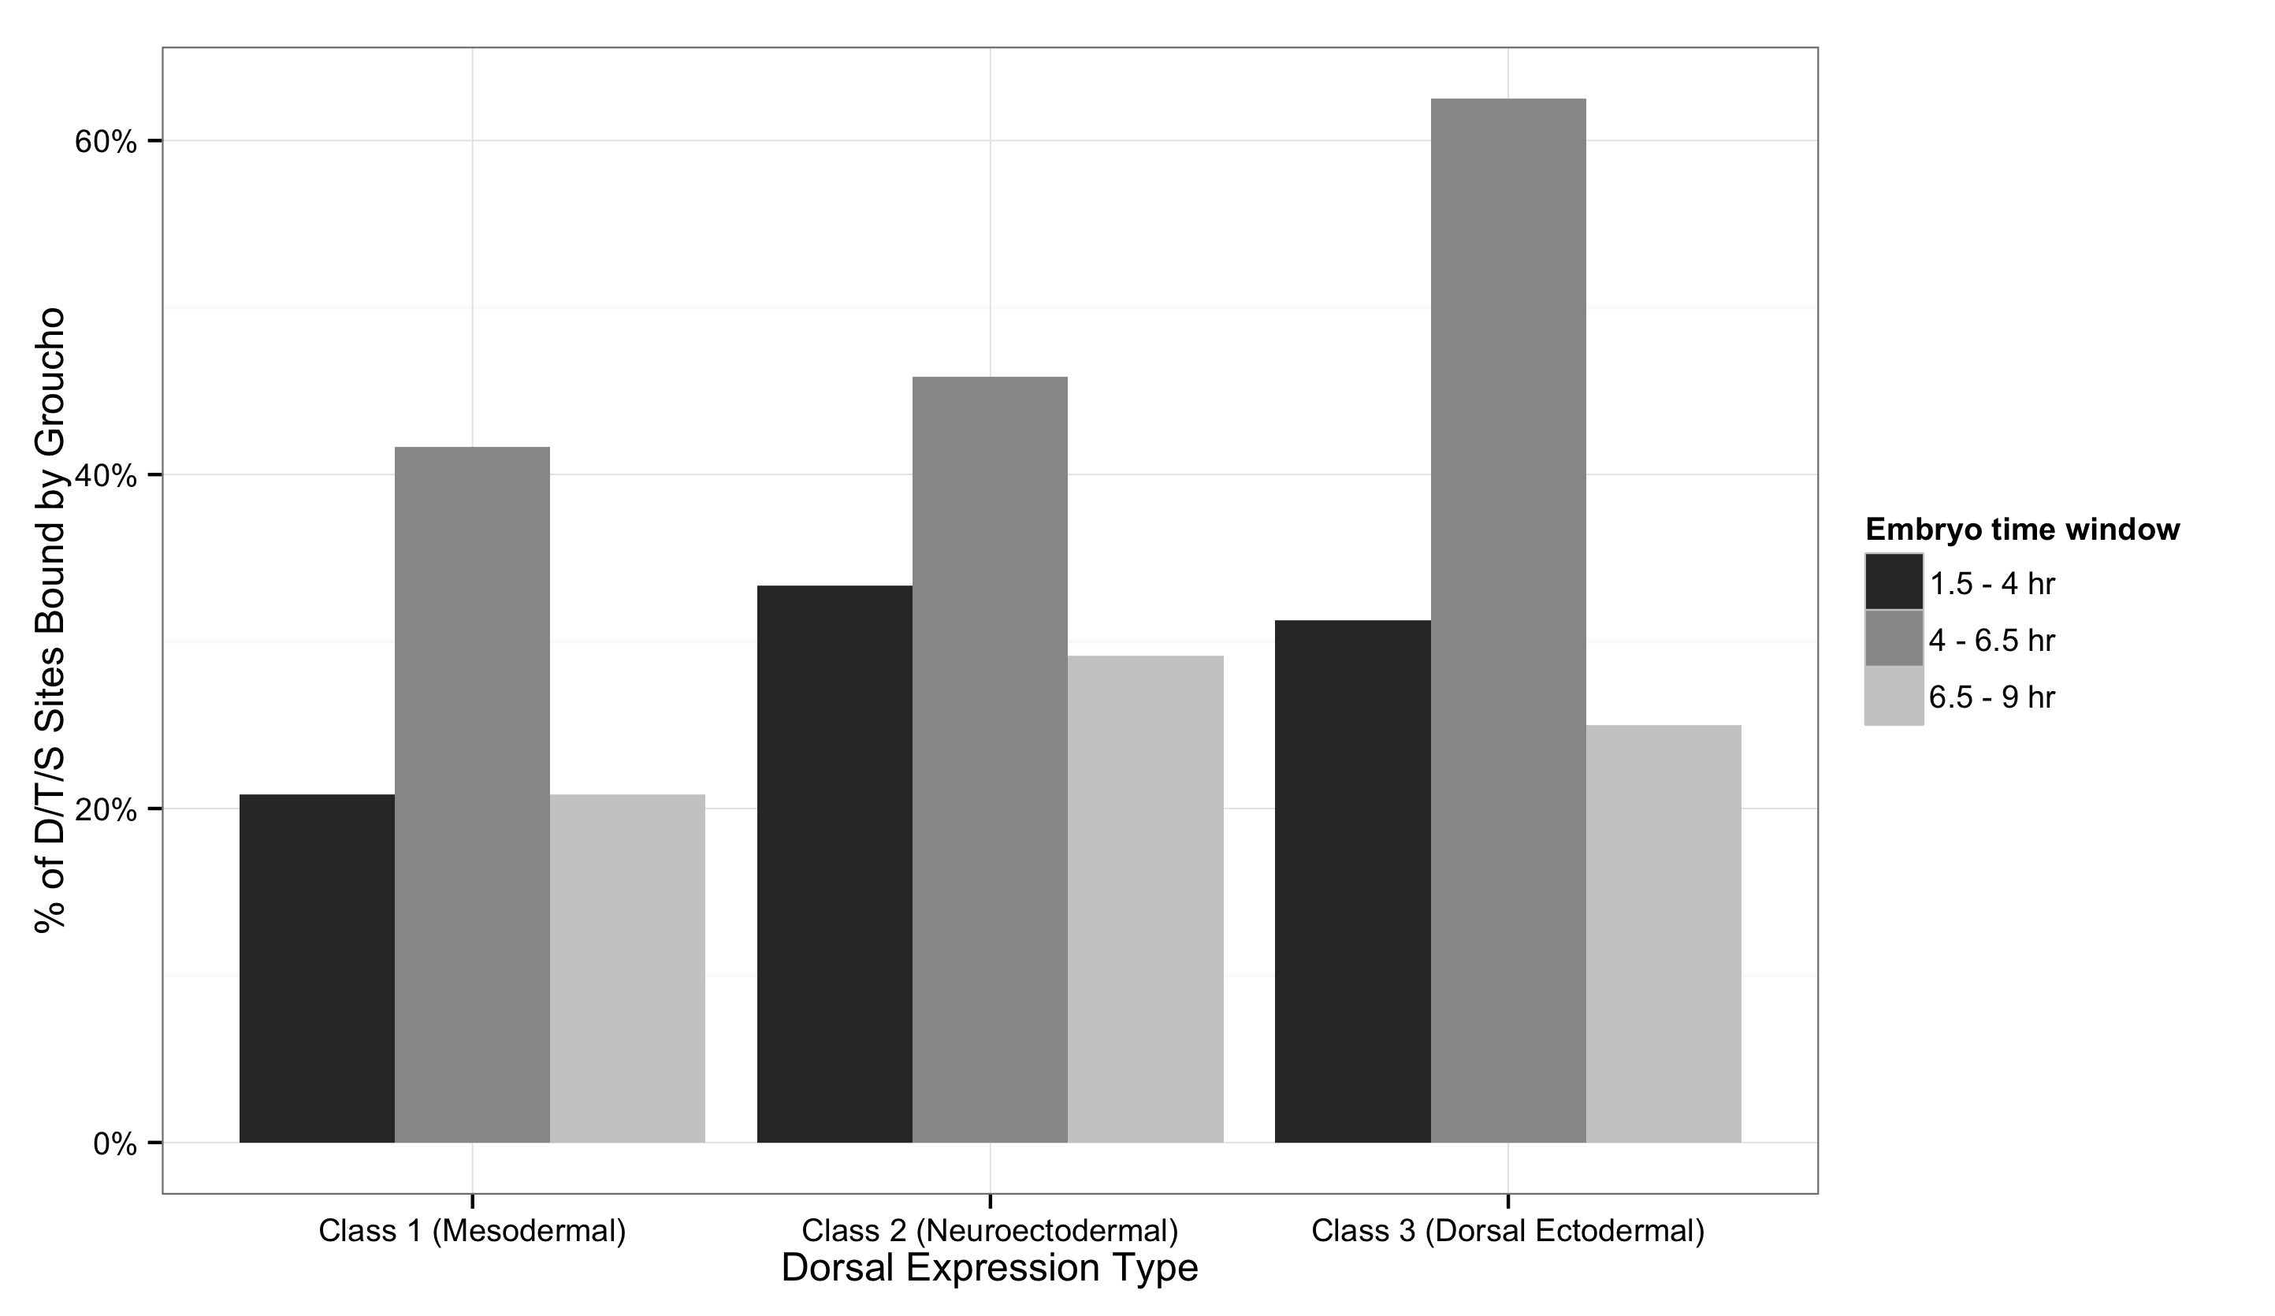
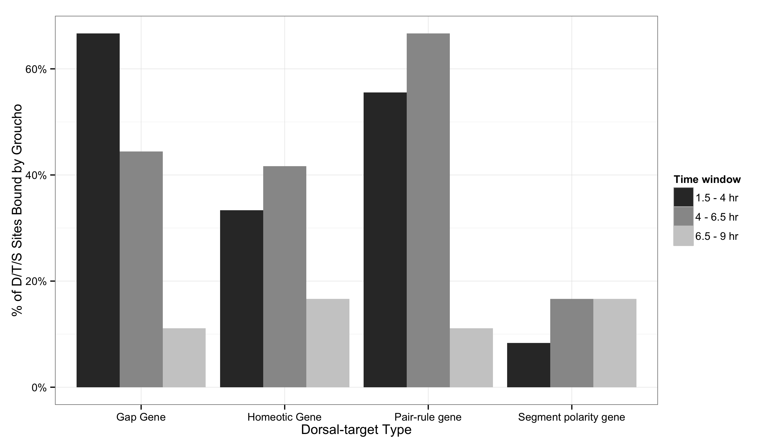
Gro associates with Dorsal irrespective of Dorsal site affinity

Slide 15
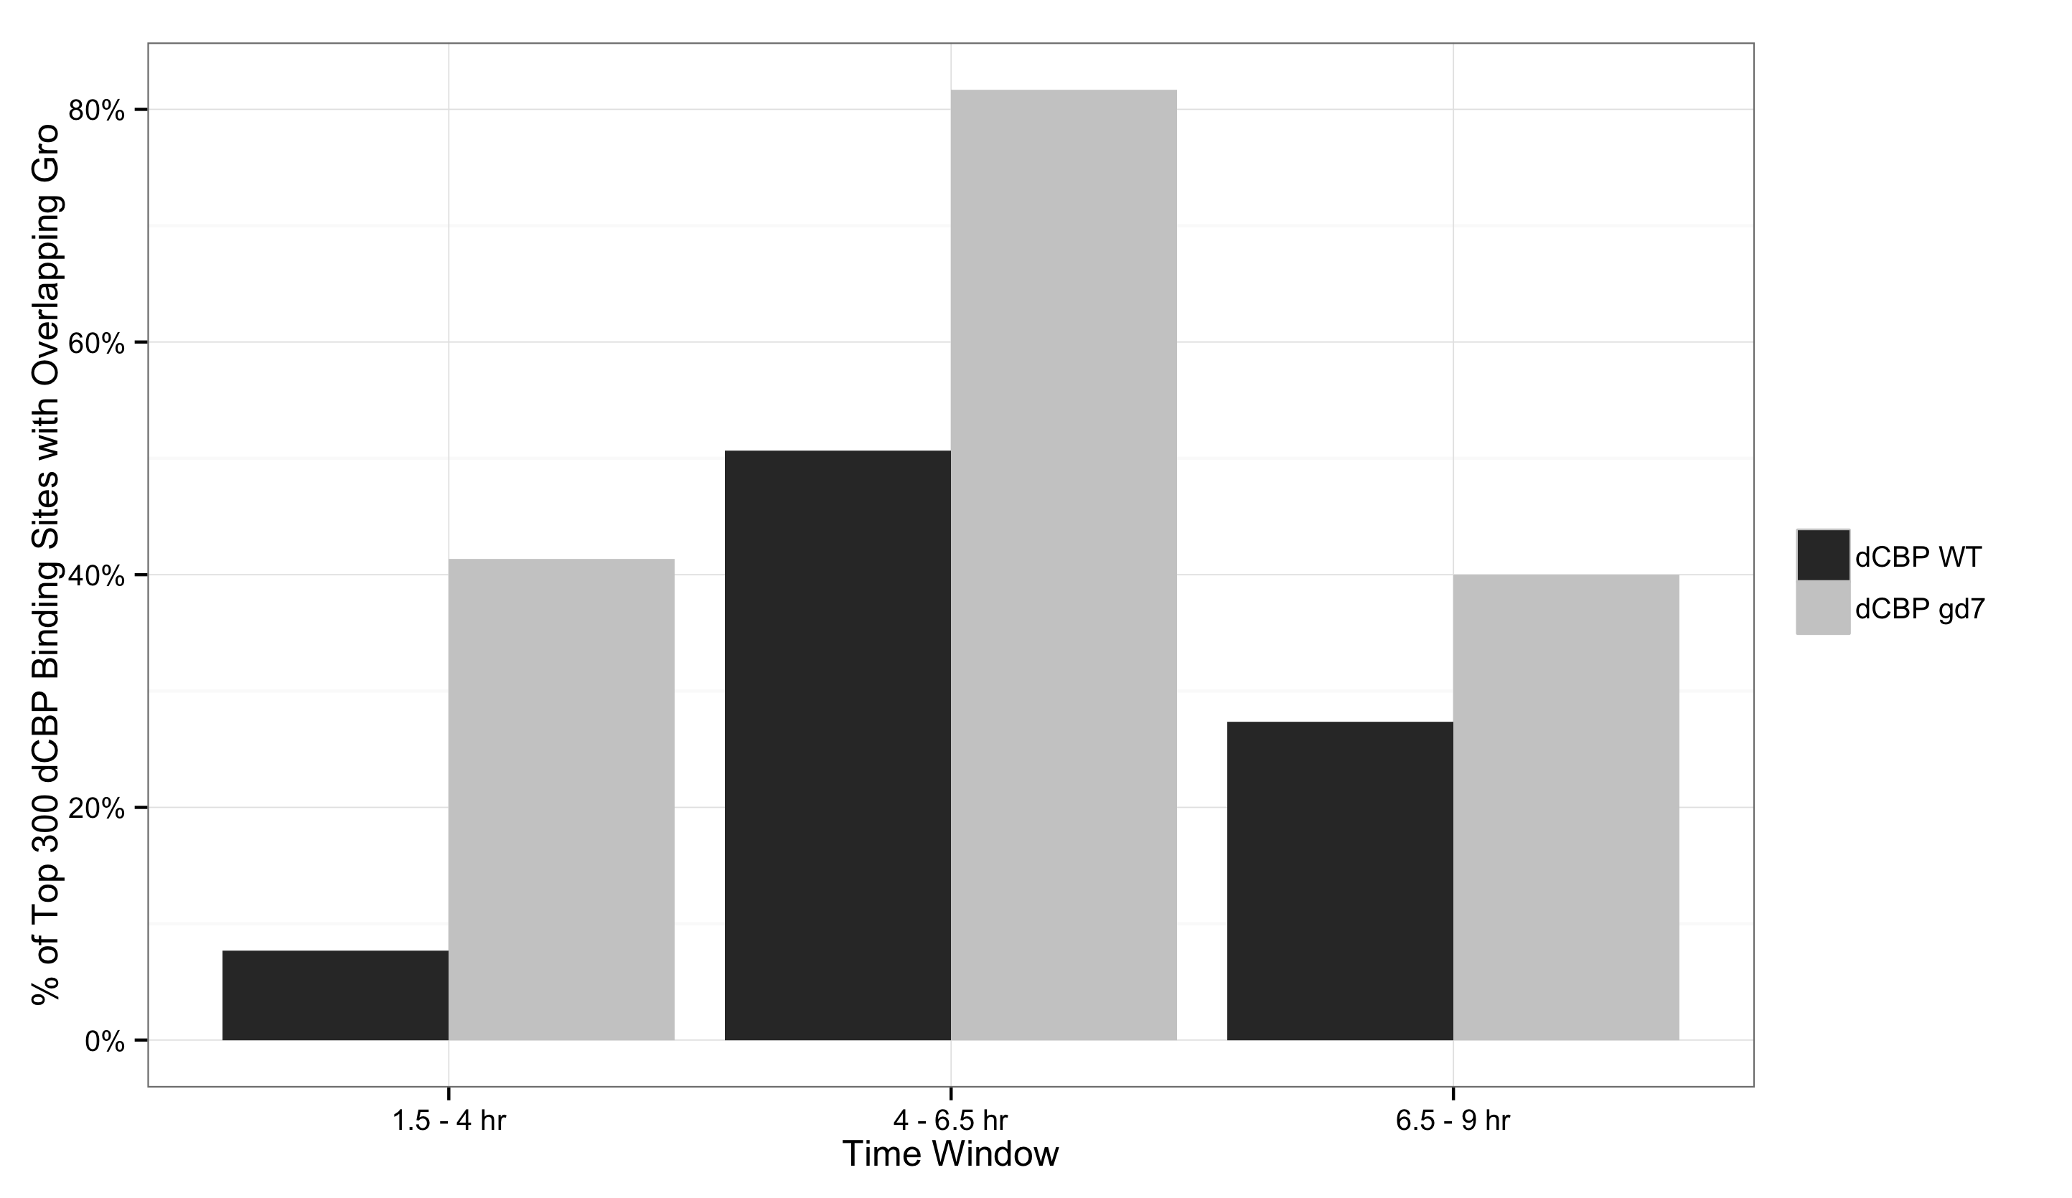
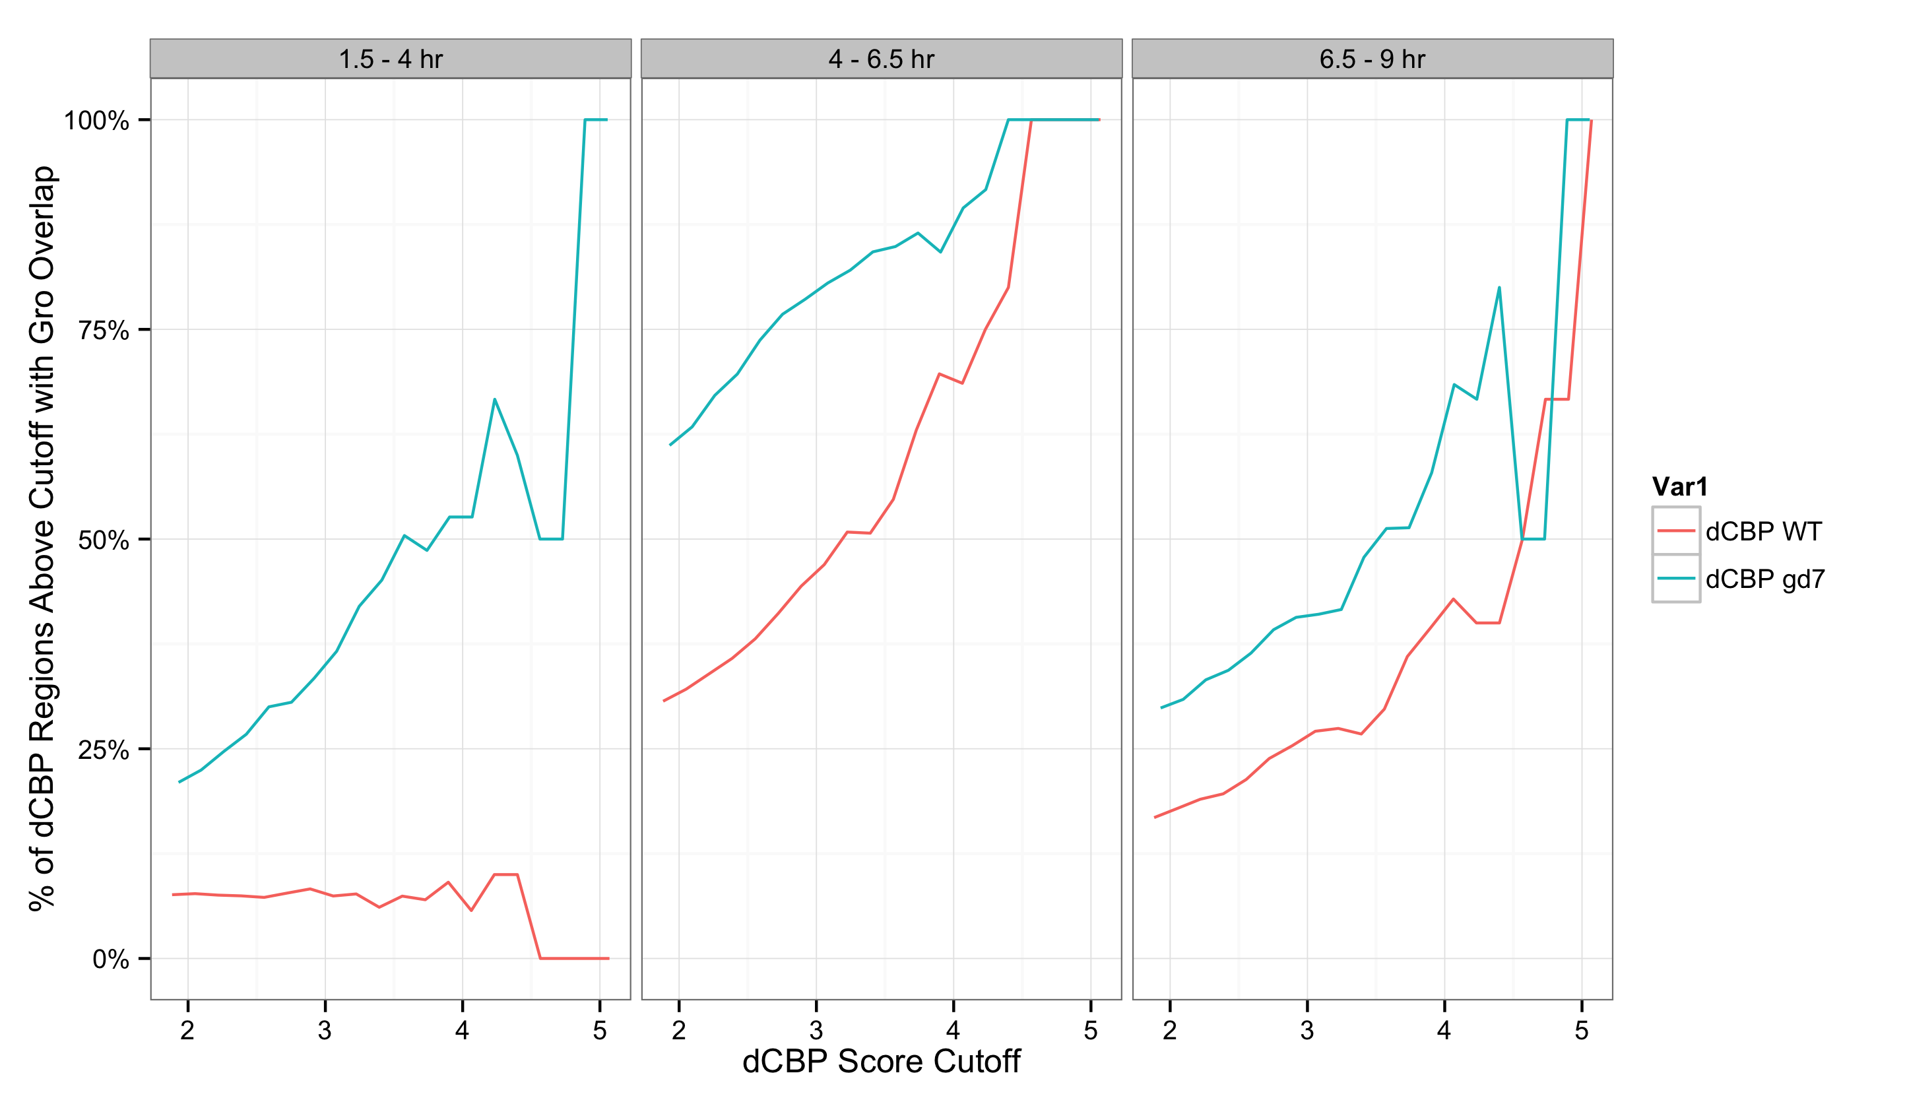
Gro occupies both Dorsal-dependent and –independent CBP binding sites

Slide 16
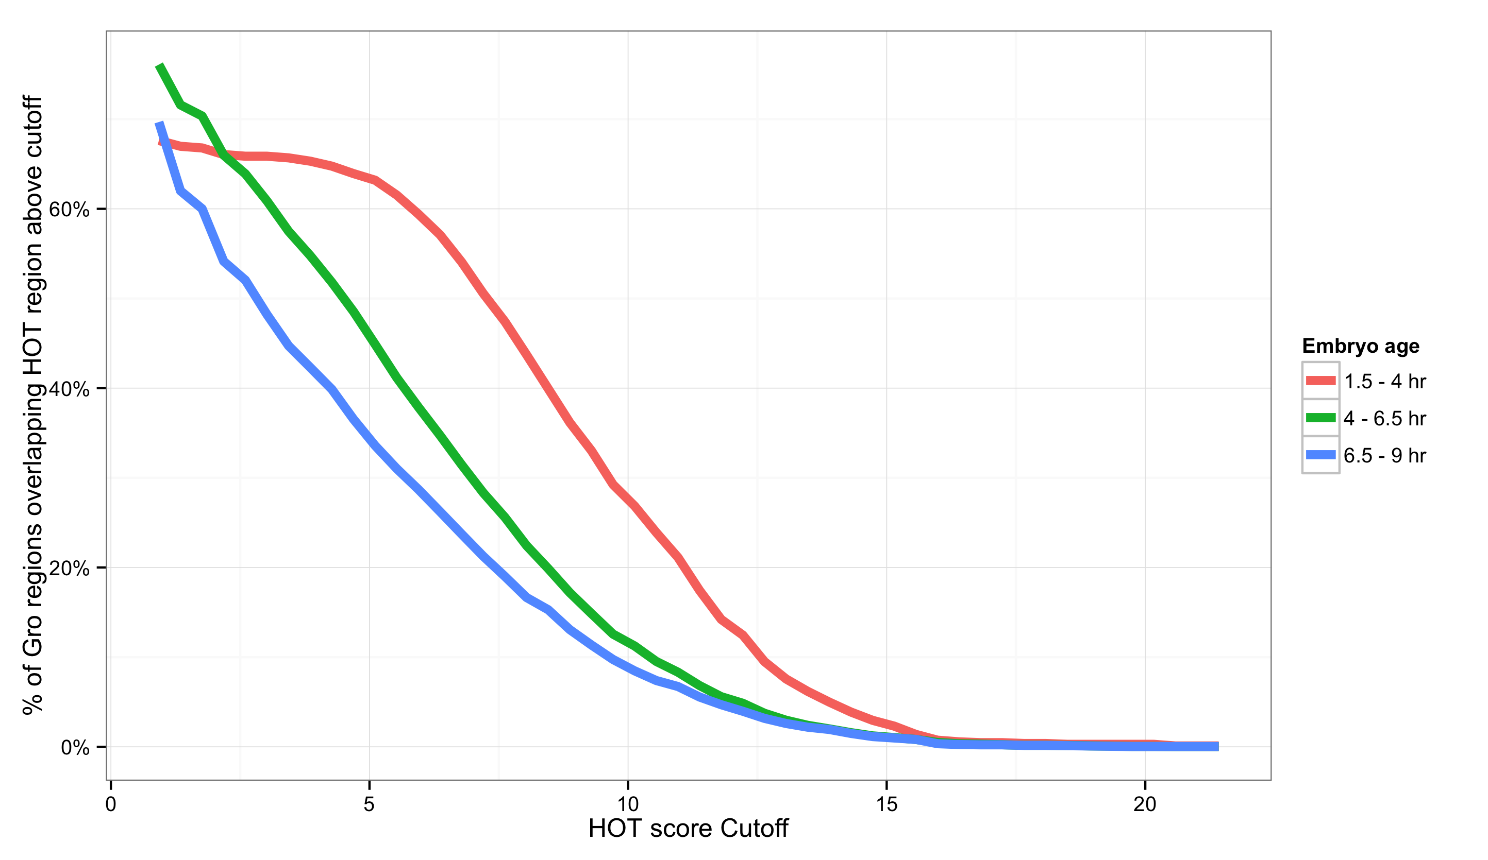
Gro occupies HOTter regions during early time stages

Slide 17
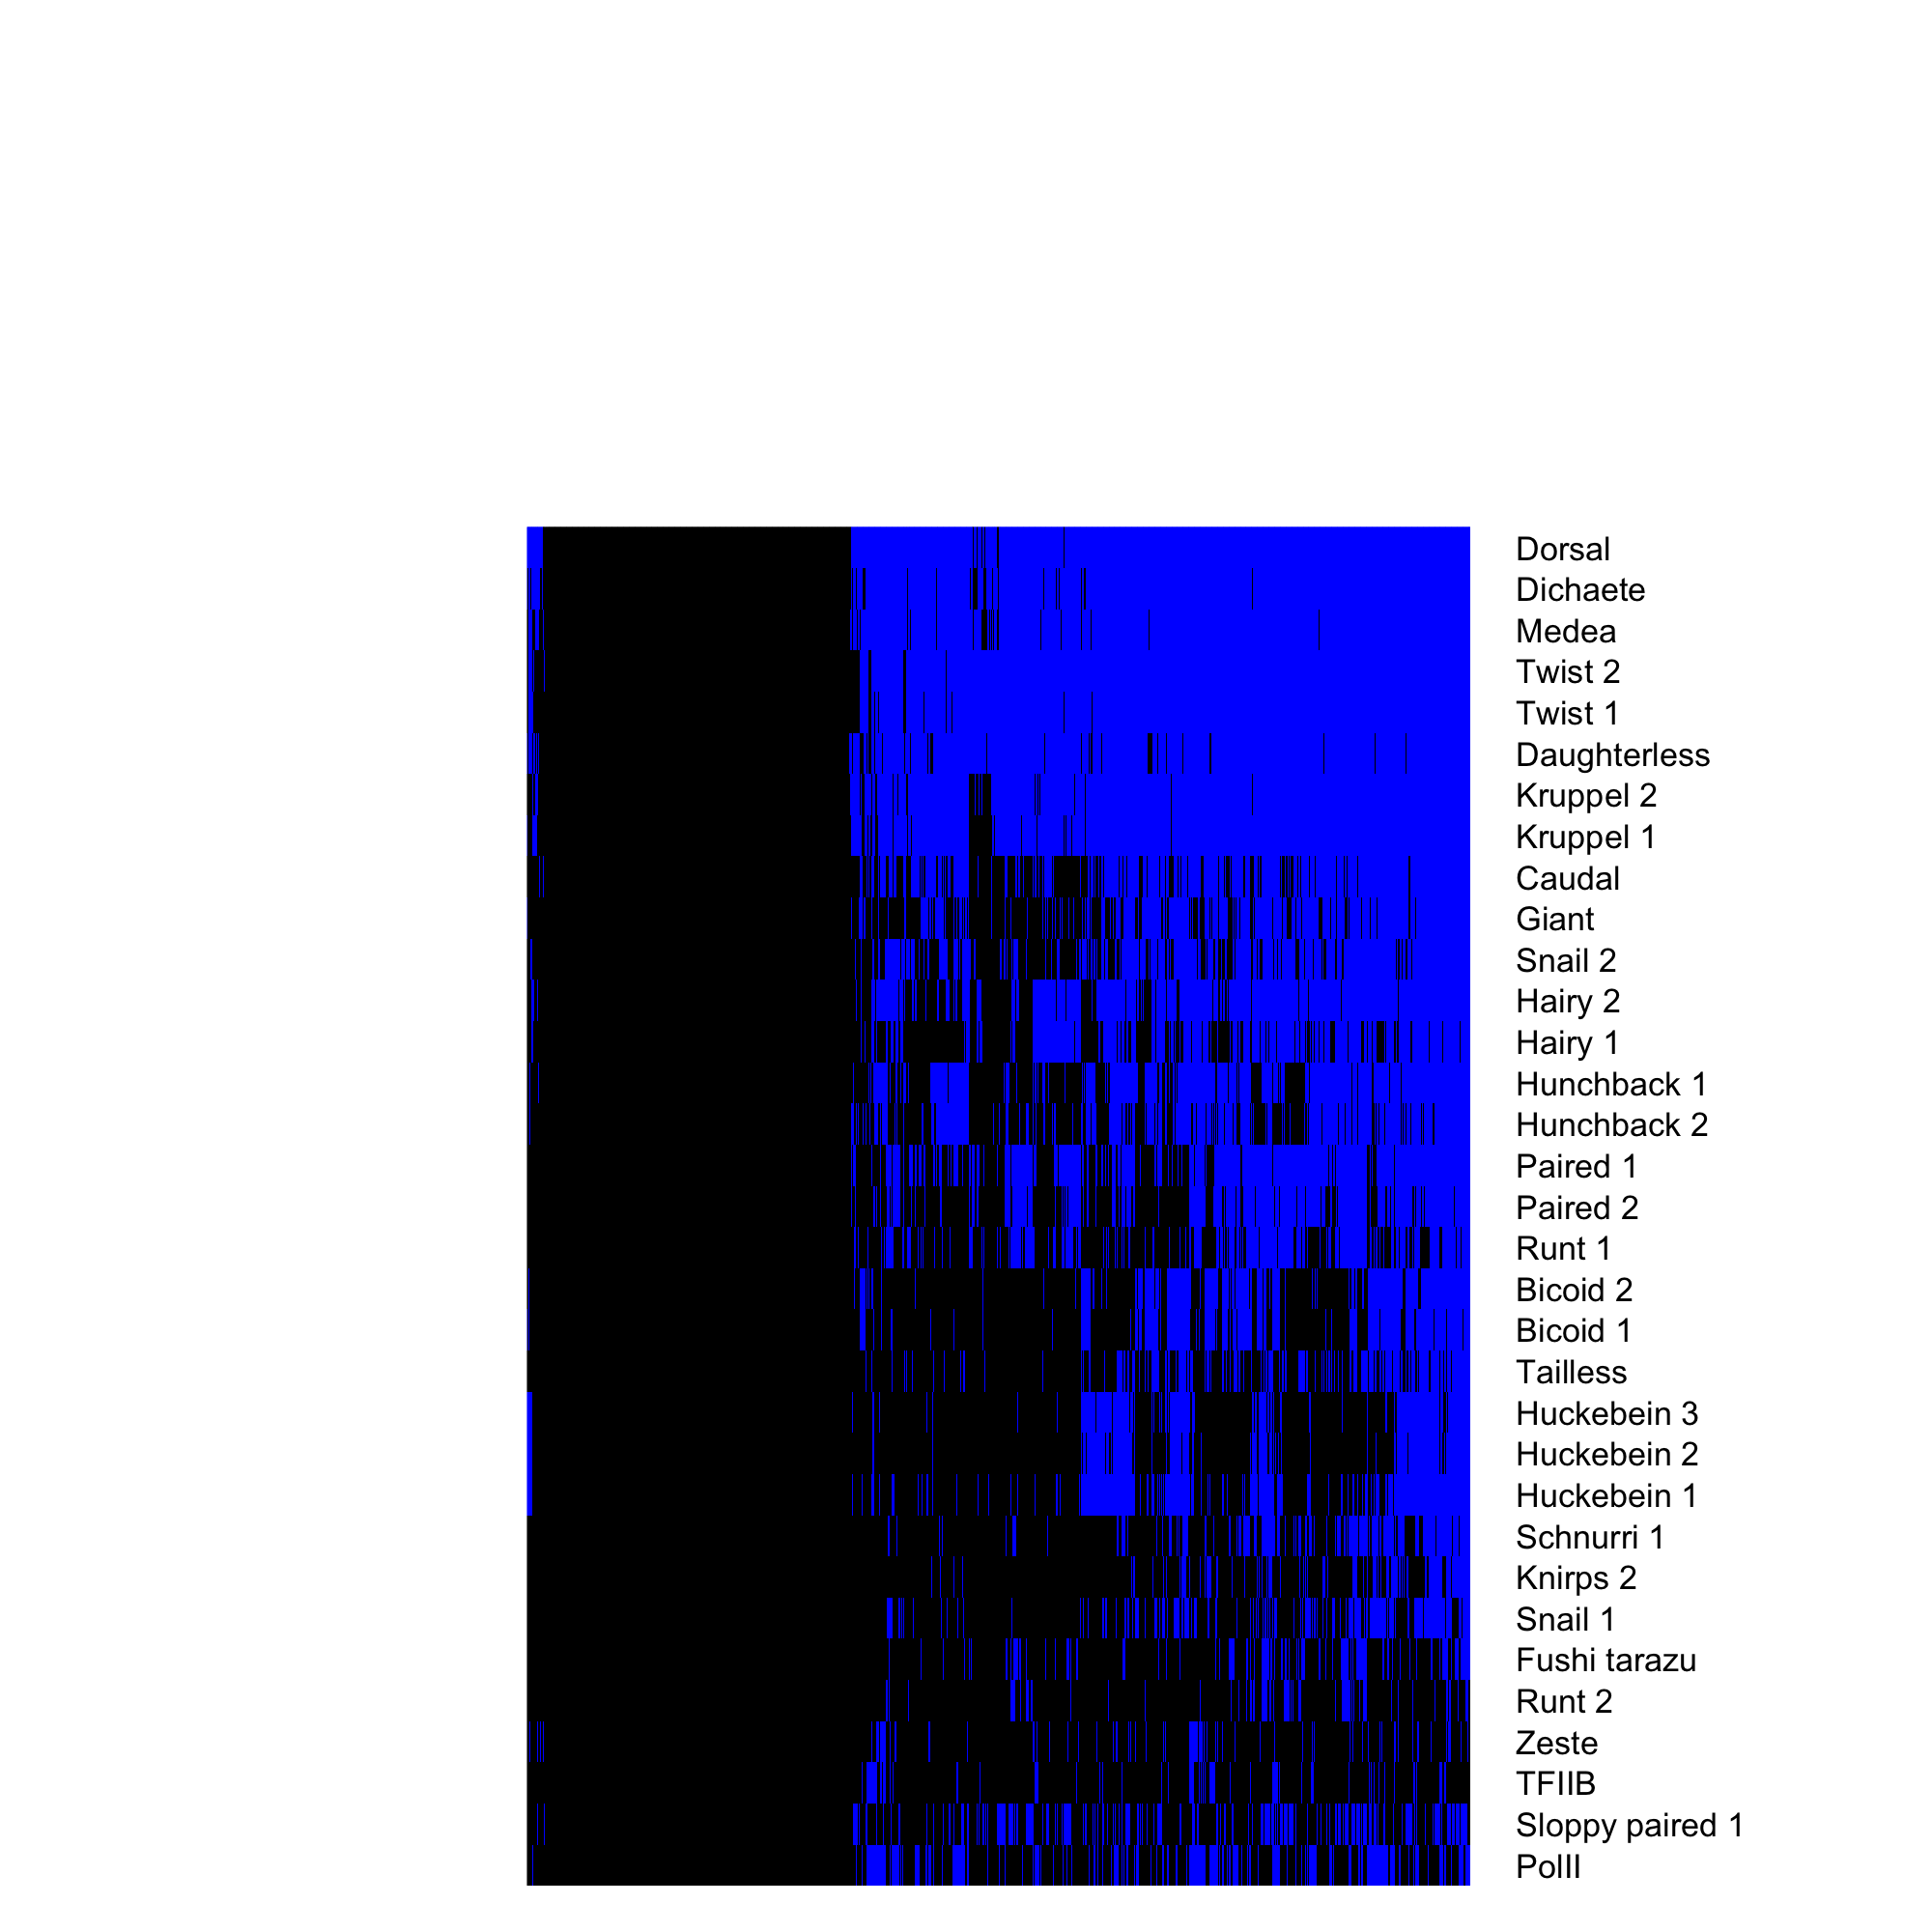
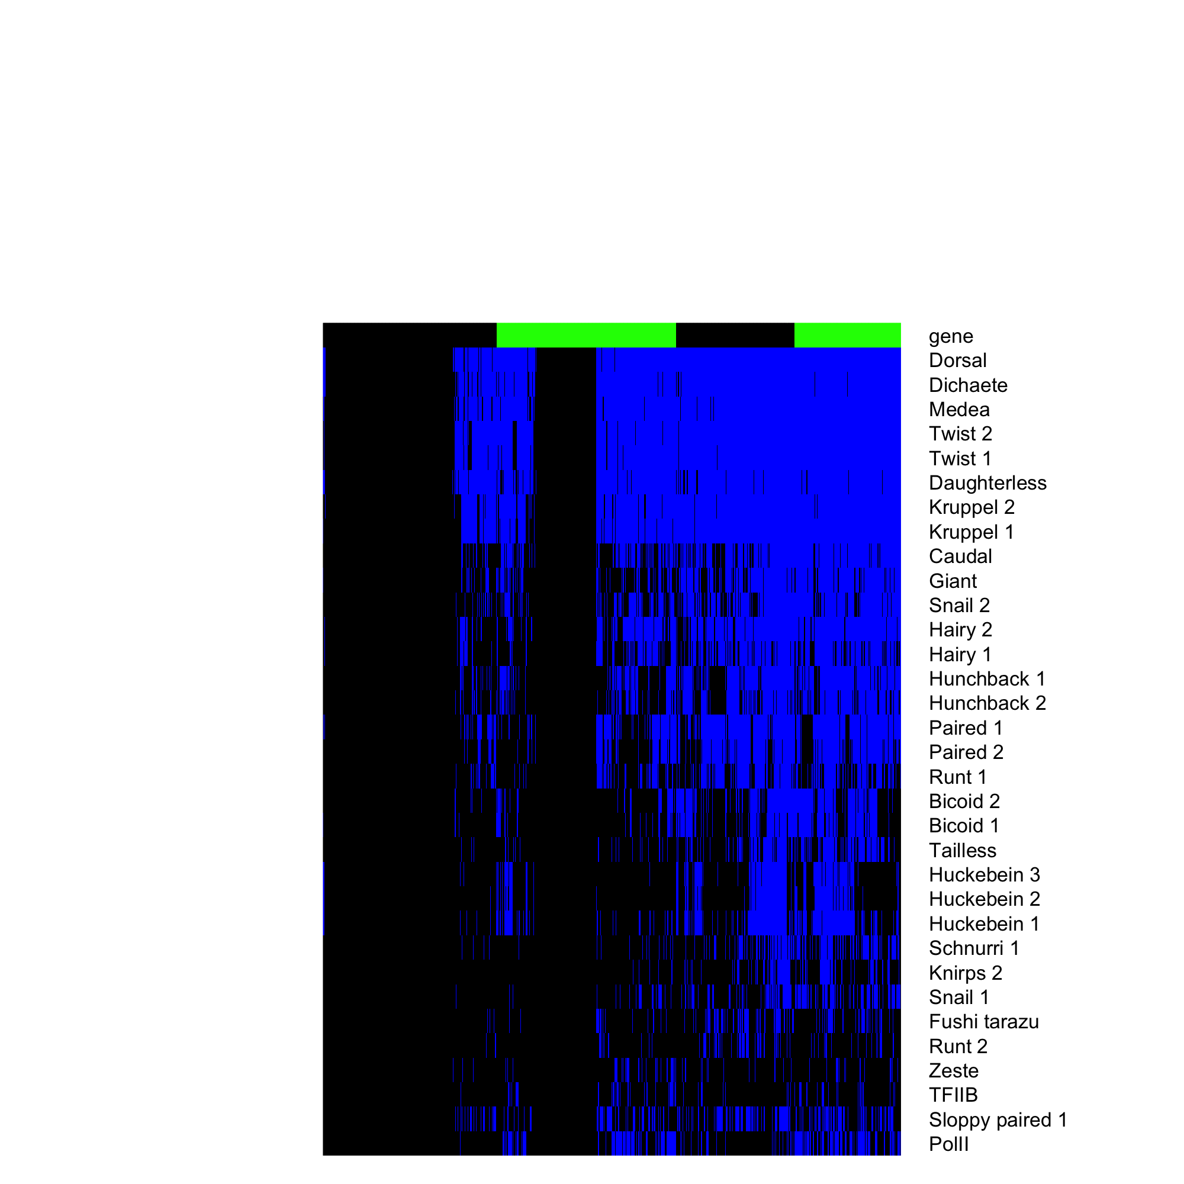
Gro recruitment is strongly dependent on combinatorial binding with Dorsal plus additional factors

Slide 18
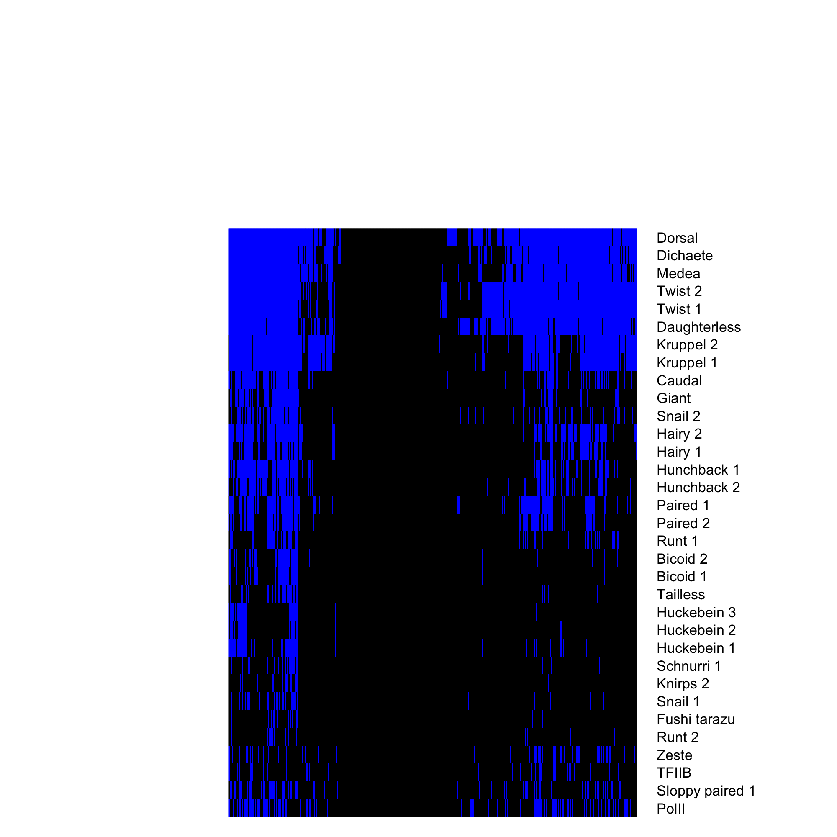
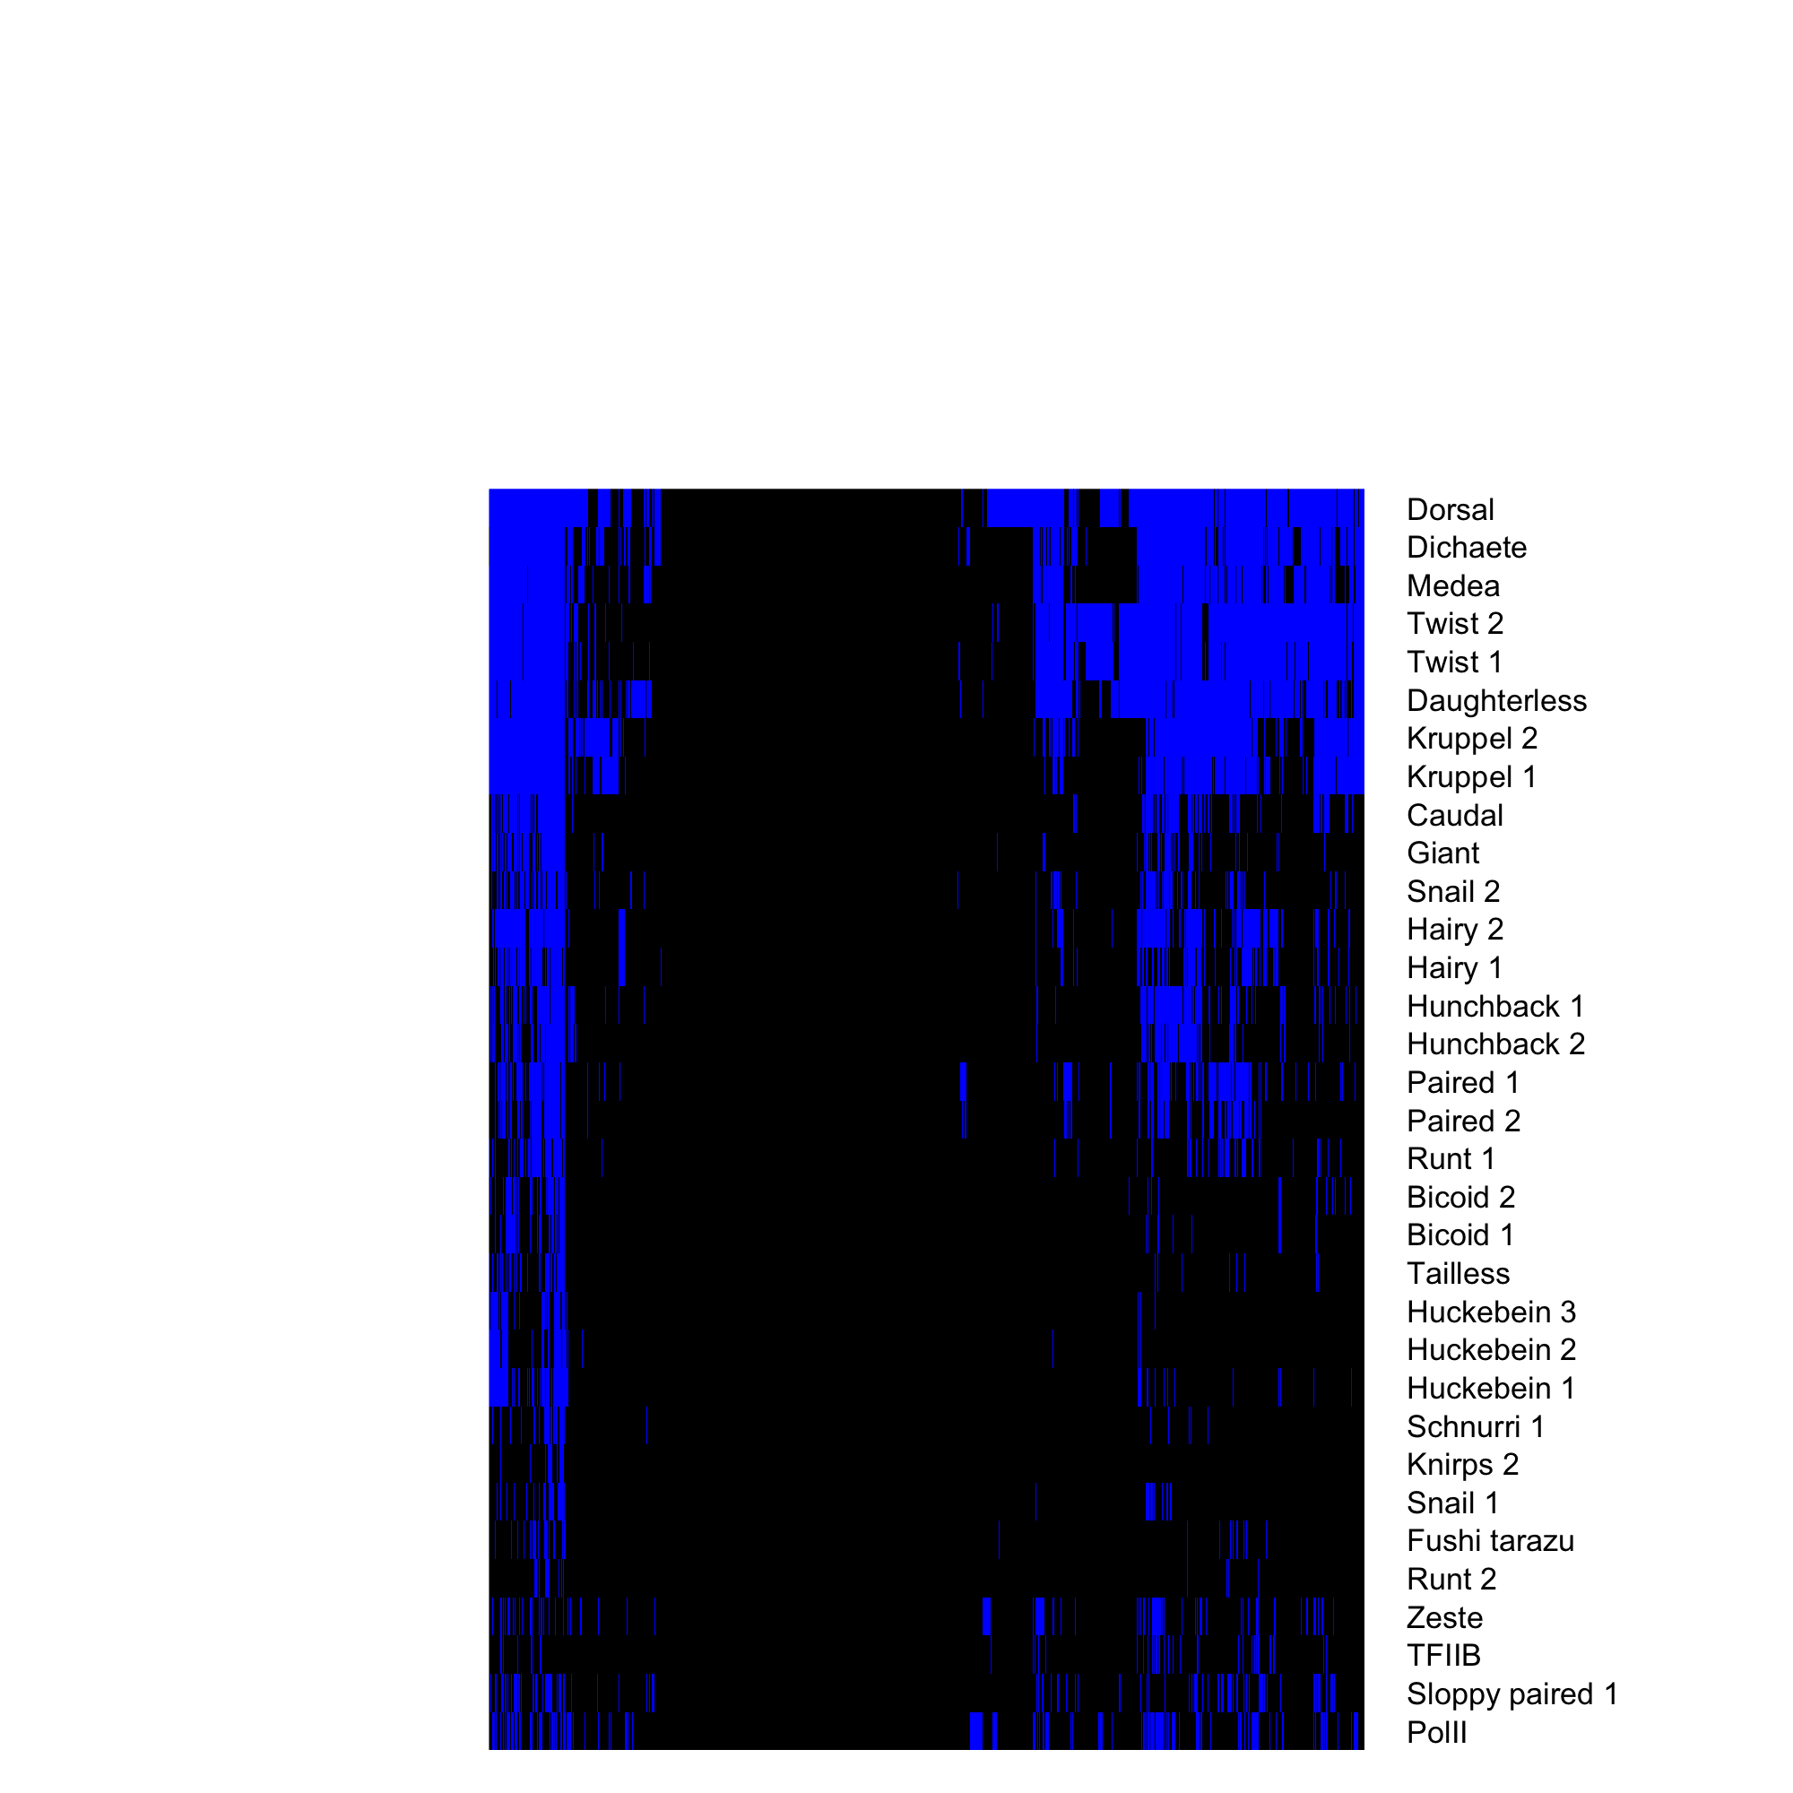
4 – 6.5 hr
6.5 – 9 hr

